Slide 1
Database System
Saba Ghani
FAST-NU
Chiniot-Faisalabad campus

Slide 2
Topics
Relationship, types of relationship sets.
Role and Structure constraints,

Slide 3
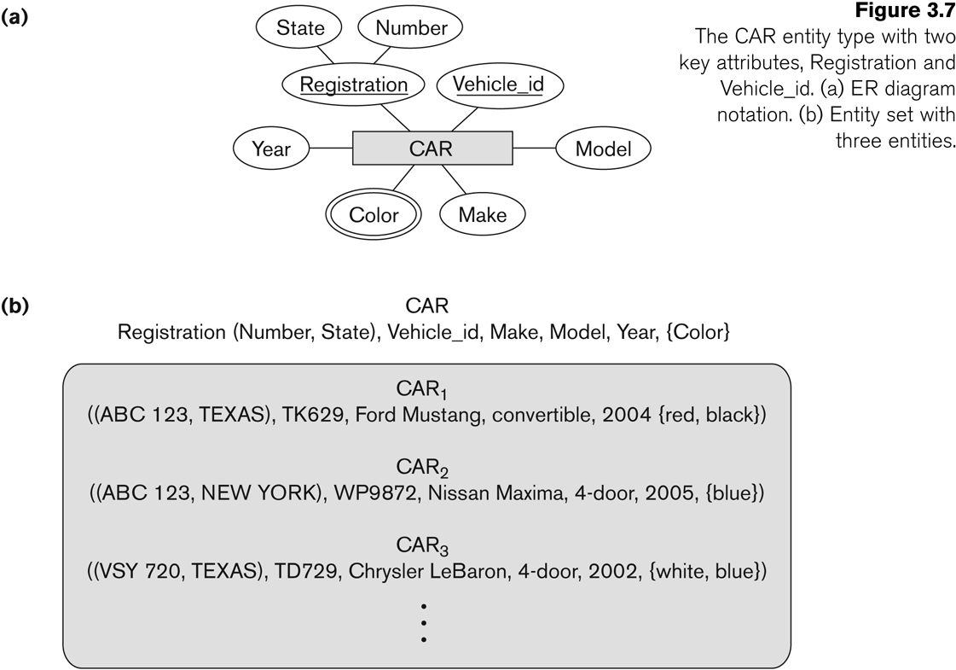
Entity Type CAR with two keys and a corresponding Entity Set

Slide 4
Relationship
An association between two or more entities, of significance to the enterprise
The relationship type is modeled as the diamond and lines between entity type
SHIP
SUPPLIER
PART
SHIP
SUPPLIER
PART
WORK FOR
EMPLOYEE
COMPANY
WORK FOR
EMPLOYEE
COMPANY

Slide 5
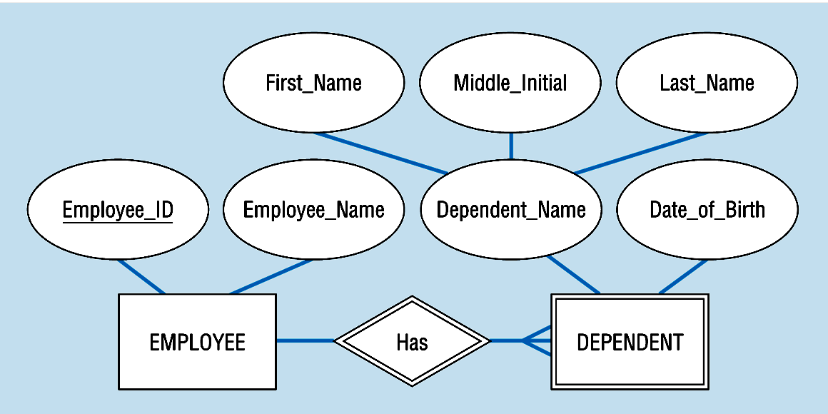
Identifying relationship
links strong entities to weak entities
represented with double line diamond

Slide 6
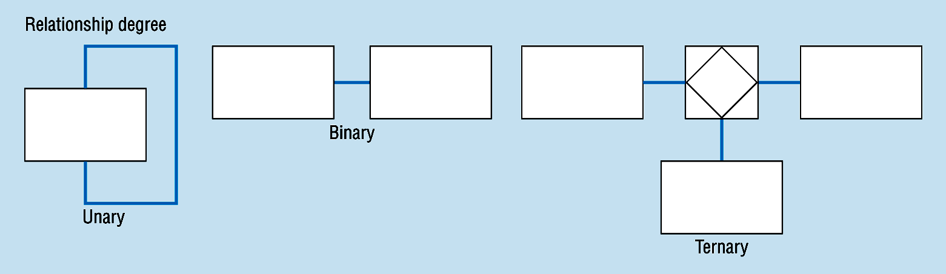
Degree of Relationships
Degree of a Relationship is the number of entity types that participate in it
Unary Relationship
Binary Relationship
Ternary Relationship
N-ary Relationship
One entity related to another of the same entity type
Entities of two different types related to each other
Entities of three different types related to each other

Slide 7
Unary Relationships
A relationship between instances of a single entity type.
Also called recursive relationship.
EMPLOYEE Manages EMPLOYEE
PERSON is Married to PERSON
Manages
Is Married to
EMPLOYEE
PERSON

Slide 8
Binary Relationships
A relationship between the instances of two entity types.
PARKING SPACE is assigned to EMPLOYEE.
STUDENT is registered in COURSES
EMPLOYEE
assigned
PARKING SPACE
STUDENT
registered
COURSES

Slide 9
Ternary Relationship
A simultaneous relationship among the instances of three entity types.
TEACHES
TEACHER
COURSES
TEACHES
TAKES
STUDENTS
TEACHER
TEACHES
COURSES
STUDENTS

Slide 10
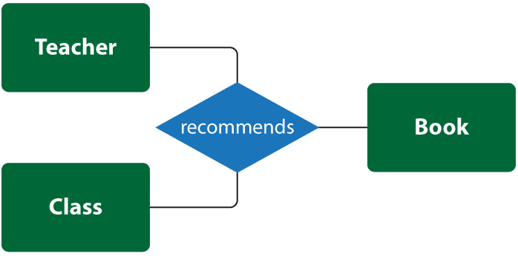

Slide 11
N-ary Relationship
A relationship between the instances of N entity types.

Slide 12
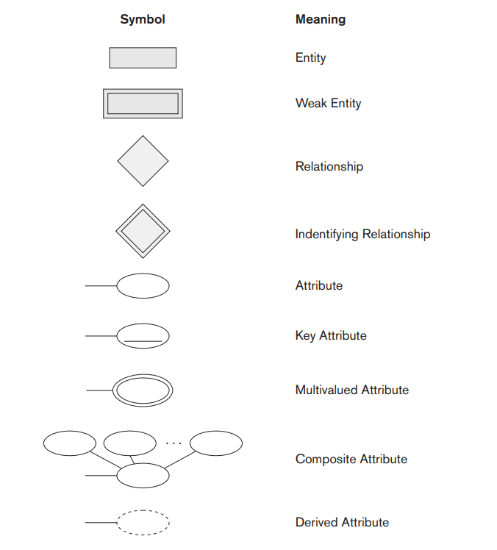

Slide 13

Cardinality Constraints
Number of entity instance taking part in relationship:
The number of instances of one entity that can or must be associated with each instance of another entity.
Minimum Cardinality
If zero, then optional
If one or more, then mandatory
Maximum Cardinality
The maximum number

Slide 14
Cardinality of Relationship
One – to – One (1-1)
Each entity in the relationship will have exactly one related entity
One – to – Many (1-N)
An entity on one side of the relationship can have many related entities, but an entity on the other side will have a maximum of one related entity
Many – to – Many (M-N)
Entities on both sides of the relationship can have many related entities on the other side

Slide 15
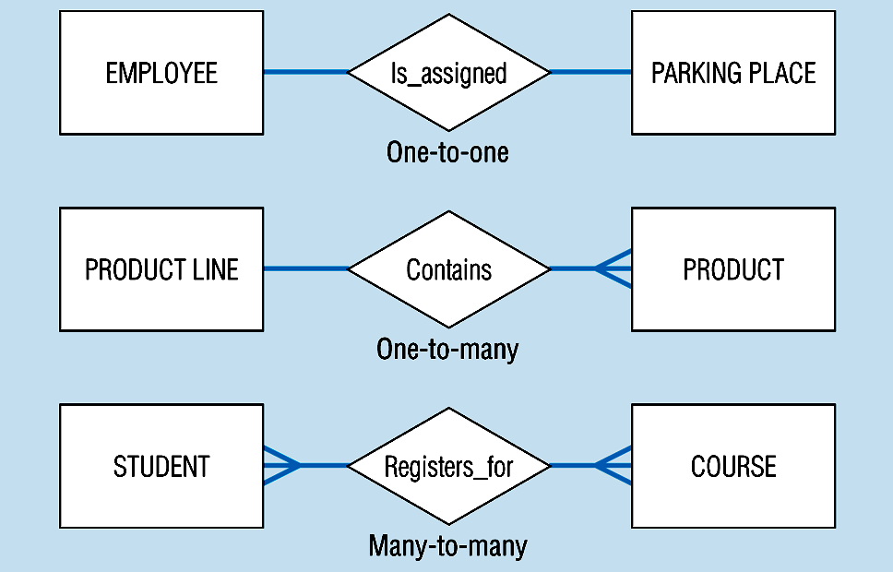

Slide 16
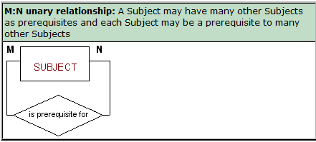
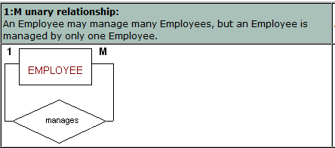

Slide 17
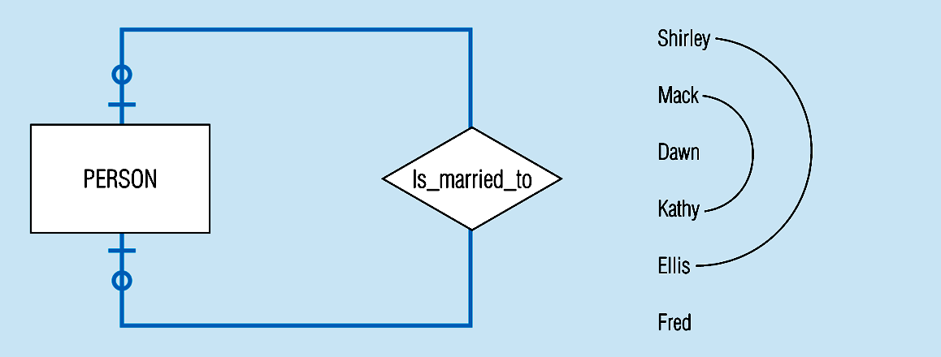
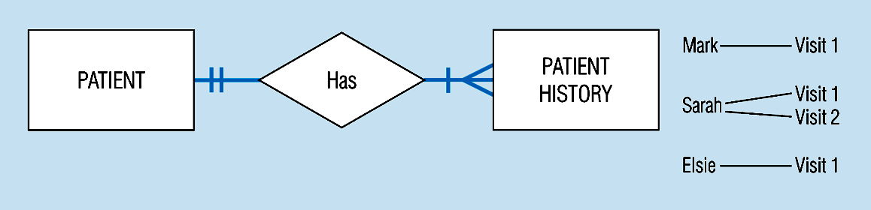
Optional cardinalities with unary degree, one-to-one relationship
Mandatory minimum cardinalities

Slide 18
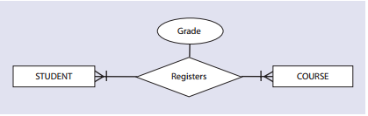
CUSTOMER
submit
ORDER

Slide 19
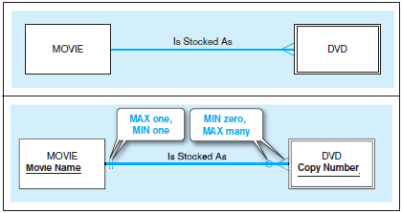

Slide 20
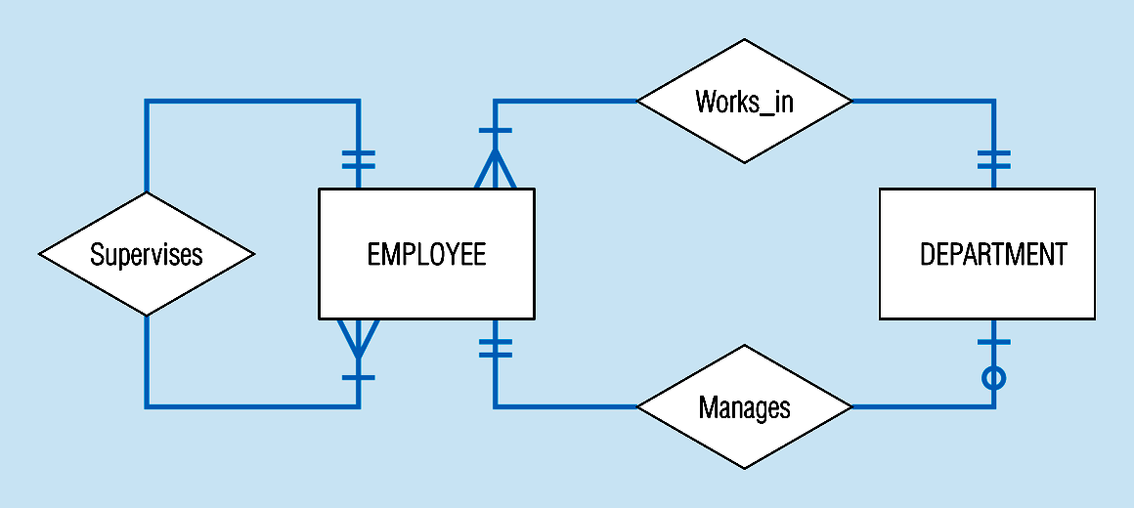

Slide 21
has
PERSON
CARD
Is For
DRIVING LICENSE
PERSON
has
PERSON
Birth place

Slide 22
Associative Entity
It’s an entity – it has attributes
AND it’s a relationship – it links entities together
When should a relationship with attributes instead be an associative entity?
All relationships for the associative entity should be many
The associative entity could have meaning independent of the other entities
The associative entity preferably has a unique identifier, and should also have other attributes
The associative may be participating in other relationships other than the entities of the associated relationship
Ternary relationships should be converted to associative entities

Slide 23
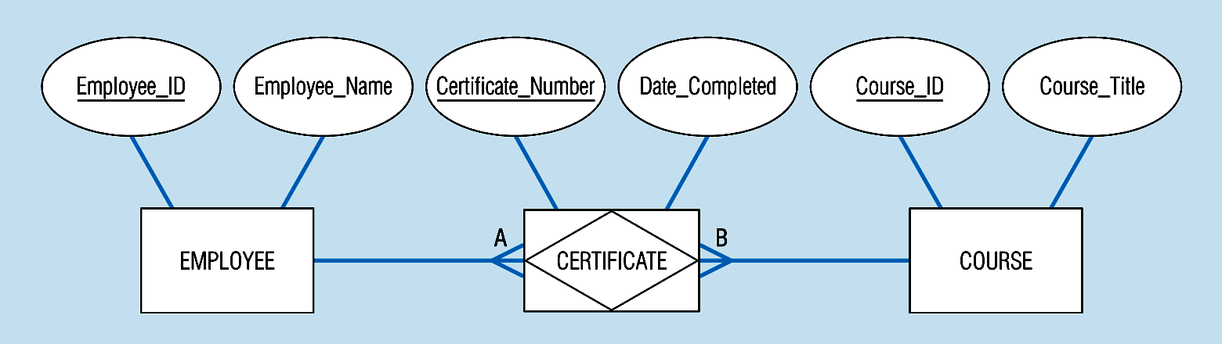
Associative entity involves a rectangle with a diamond inside.
Note that the many-to-many cardinality symbols face toward the associative entity and not toward the other entities

Slide 24
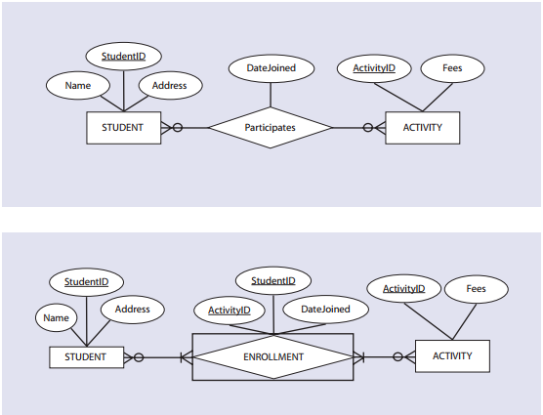
Each instance of the STUDENT entity is related to as many instances of the ENROLLMENT entity as the number of activities in which the student participates.
Therefore, there is a one-to-many relationship between the STUDENT entity type and the ENROLLMENT entity type.
Similarly, there is a one-to-many relationship between the entity types ACTIVITY and ENROLLMENT because several students may enroll in one activity.

Slide 25
EXAMPLE COMPANY Database
Requirements for the COMPANY Database:
- The company is organized into DEPARTMENTs, department has a name, number, and an employee who manages the department.
We keep track of the start date of the department manager. A department may have several locations.
- Each department controls a number of PROJECTs. Each project has a name, number, and is located at a single location.
- We store each EMPLOYEE's social security number, address, salary, sex, and birth date. Each employee works for one department but may work on several projects.

Slide 26
EXAMPLE COMPANY Database
We keep track of the number of hours per week that an employee currently works on each project.
We also keep track of the direct supervisor of each employee
Each employee may have a number of DEPENDENTs.
For each dependent, we keep their name, sex, birth date, and relationship to the employee.

Slide 27
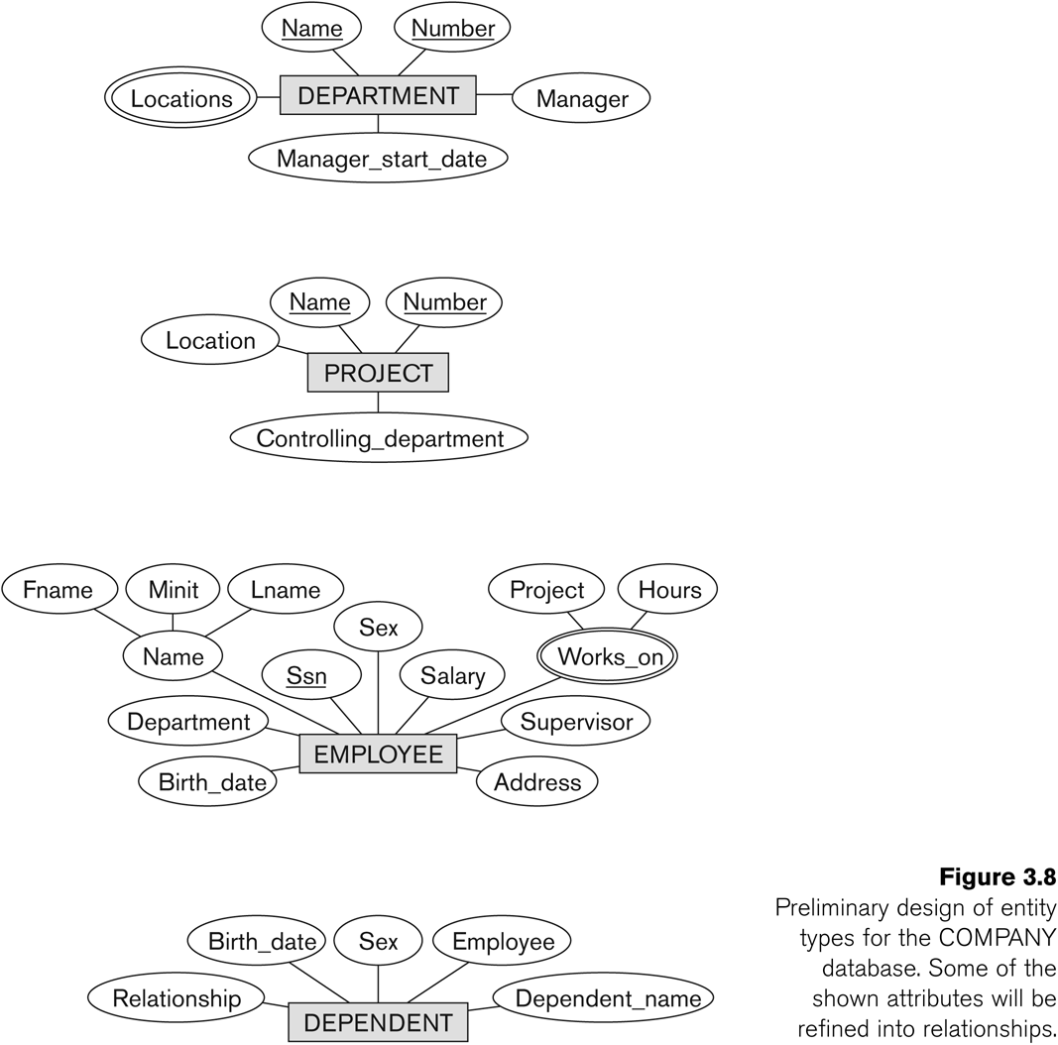
Initial Design of Entity Types: EMPLOYEE, DEPARTMENT, PROJECT, DEPENDENT

Slide 28
ERD
A graphical representation of an entity-relationship model
logical representation of the data for an organization or for a business area, using entities for categories of data and relationships for associations between entities.

Slide 29
Entity Relationship Diagram
Name
Name
Location
location
Number
Number
Manger_start_date
Pid
CONTROLs
Manger
DEPARTMENT
PROJECT
city
State
Pid
MANAGES
Country
Eid
N_o_hr
Street
Works_ On
Birth_date
Address
House#
Department
Sex
EMPLOYEE
HAS
HAS
DEPENDENT
SSn
Employee
Salary
Supervisor
Name
Lname
Relationship
Work_on
Sex
Dependent Name
Fname
Mname
Project
Hourse
Birth_date

Slide 30
Class Task 1
A hospital has a large number of registered physicians. Attributes of PHYSICIAN include Physician ID (the identifier) and Specialty.
Patients are admitted to the hospital by physicians. Attributes of PATIENT include Patient ID (the identifier) and Patient Name.
Any patient who is admitted must have exactly one admitting physician. A physician may optionally admit any number of patients. Once admitted, a given patient must be treated by at least one physician. A particular physician may treat any number of patients, or may not treat any patients.
Whenever a patient is treated by a physician, the hospital wishes to record the details of the treatment (Treatment Detail). Components of Treatment Detail include Date, Time, and Results.

Slide 31
Class Task 2
A laboratory has several chemists who work on one or more projects. Chemists also may use certain kinds of equipment on each project. Attributes of CHEMIST include Employee ID (identifier), Name, and Phone No.
Attributes of PROJECT include Project ID (identifier) and Start Date. Attributes of EQUIPMENT include Serial No and Cost. The organization wishes to record Assign Date—that is, the date when a given equipment item was assigned to a particular chemist working on a specified project
A chemist must be assigned to at least one project and one equipment item.
A given equipment item need not be assigned, and a given project need not be assigned either a chemist or an equipment item.

Slide 32
Activity 01
A company has a number of employees. The attributes of EMPLOYEE include Employee ID (identifier), Name, Address, and Birthdate. The company also has several projects. Attributes of PROJECT include Project ID (identifier), Project Name, and Start Date. Each employee may be assigned to one or more projects, or may not be assigned to a project. A project must have at least one employee assigned and may have any number of employees assigned. An employee’s billing rate may vary by project, and the company wishes to record the applicable billing rate (Billing Rate) for each employee when assigned to a particular project.

Slide 33
Activity 02
A laboratory has several chemists who work on one or more projects. Chemists also may use certain kinds of equipment on each project. Attributes of CHEMIST include Employee ID (identifier), Name, and Phone No. Attributes of PROJECT include Project ID (identifier) and Start Date. Attributes of EQUIPMENT include Serial No and Cost. The organization wishes to record Assign Date—that is, the date when a given equipment item was assigned to a particular chemist working on a specified project. A chemist must be assigned to at least one project and one equipment item. A given equipment item need not be assigned, and a given project need not be assigned either a chemist or an equipment item. Provide good definitions for all of the relationships in this situation.

